Slide 1
Interactive Degree pathways
Capstone Project for CS 1980
Spring 2020

Slide 2
Project goal:
WHY?
To provide students/advisors with web-based, visually appealing, interactive degree pathways based on:
Academic interests (majors, minors, specializations or individualized set of electives)
Students’ intended timeline (# of semesters at Pitt)
Complex prereq/coreq structures make it hard to plan efficiently
Double-majors or minors adds even greater complexity
Students often don’t plan for a concentration or specialization until too late

Slide 3
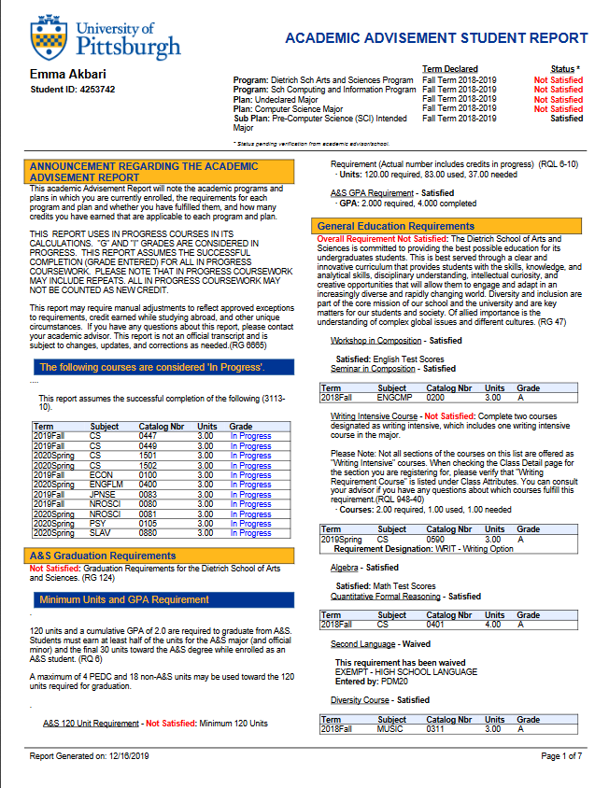
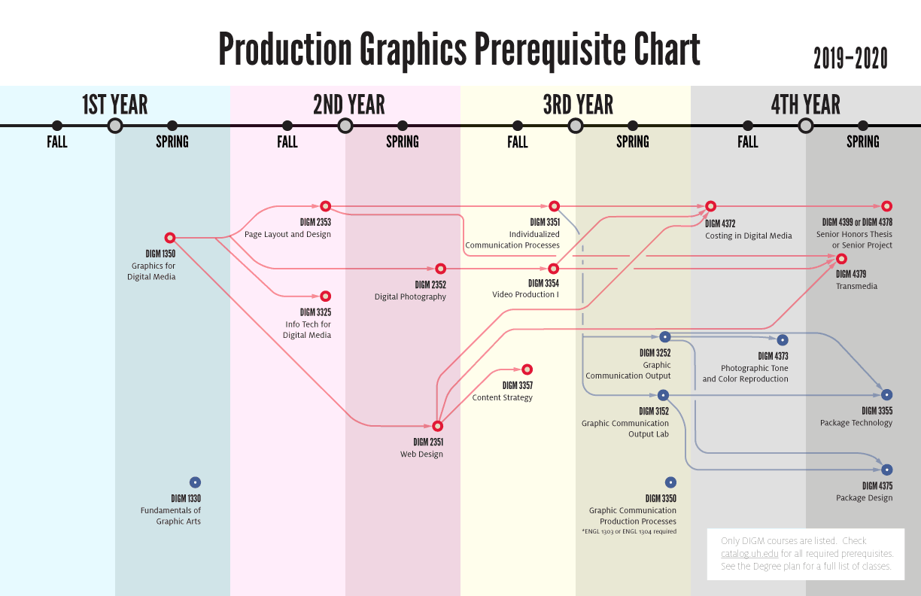
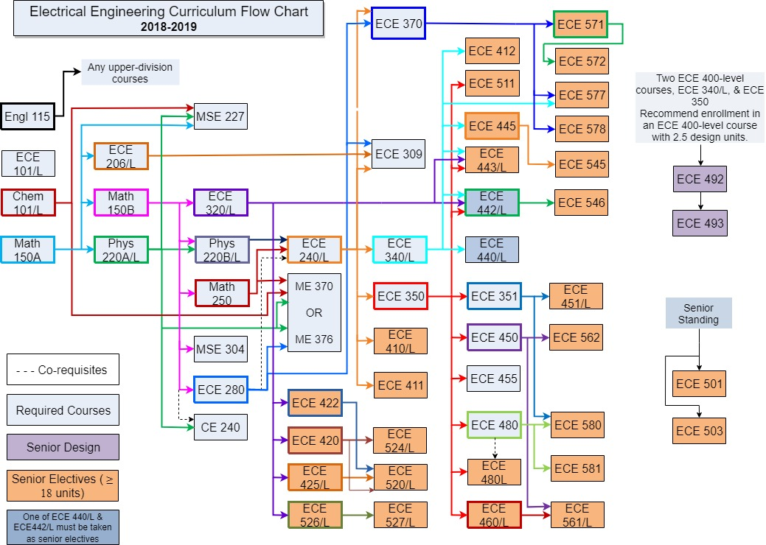
Why interactive?
Flow Charts & Degree Audits
Difficult to adjust as requirements change
Designed for students who follow a typical 4-year plan
Is focused on a single major only
Often visually unappealing or overly complex

Slide 4
basic Requirements
Interactive, web-based tool that can link to university course descriptions
Includes the prereq/coreq pathways for each SCI major (CS, IS, CompBio and DNID) including the electives (concentrations, specializations)
Shows pathways for common double-majors and major/minor pairings
Allows students to pick the number of semesters for desired completion

Slide 5
Why this project?
Gain experience working with web frameworks, integrating data sources, and interactive UI design.
Few if any existing examples—which translates to more room for creativity
Project benefits your upcoming peers in SCI
Product will be used immediately by SCI advisors

